Slide 1
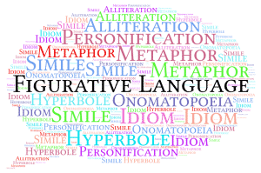
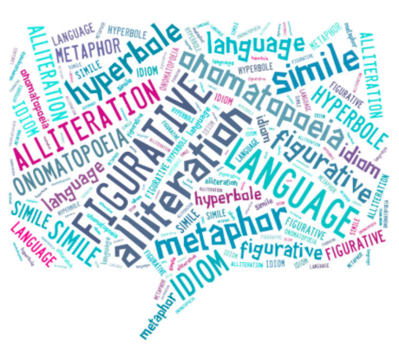
…
Figurative Language

Slide 2
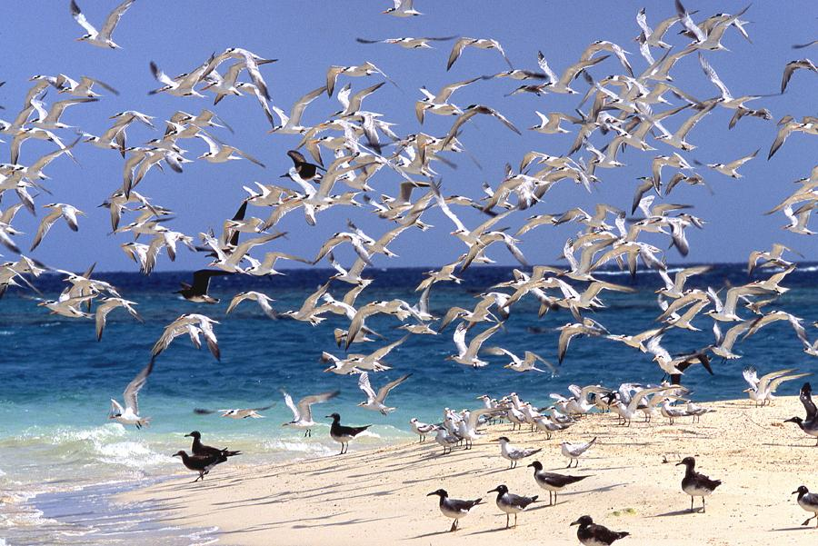
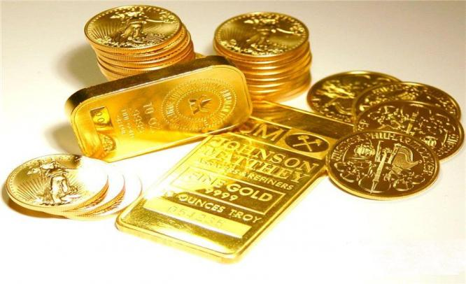
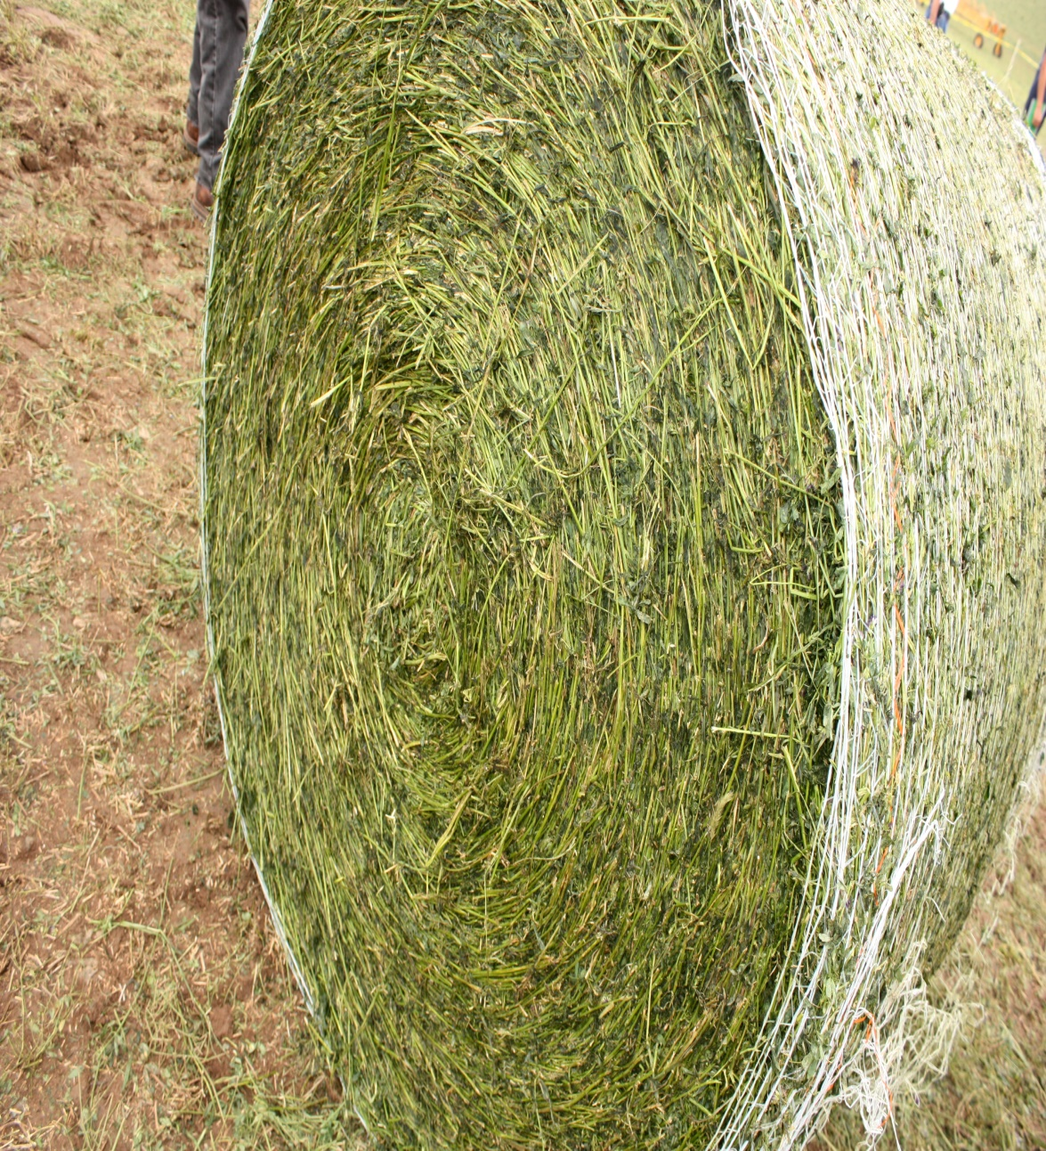
…
What do these expressions mean?
“Make Hay While the Sun Shines.”
“Birds of a feather flock together.”
“All that glitters is not gold.”
"An apple a day keeps the doctor away.“

Slide 3
…
Figurative language refers to the use of words in a way that deviates from the conventional order and meaning in order to convey a new meaning that is colorful, clearer, and exciting. Using figurative language is using ordinary words and sentence to create extraordinary meanings.
Connotative
Meaning
Metaphoric
Meaning
Idiomatic
Meaning
Daniella behaves like a tiger when she is angry.
David’s anger gave birth to all that destruction you see there.
As I came into the room, Monalisa’s eyes spoke to me to leave.

Slide 4
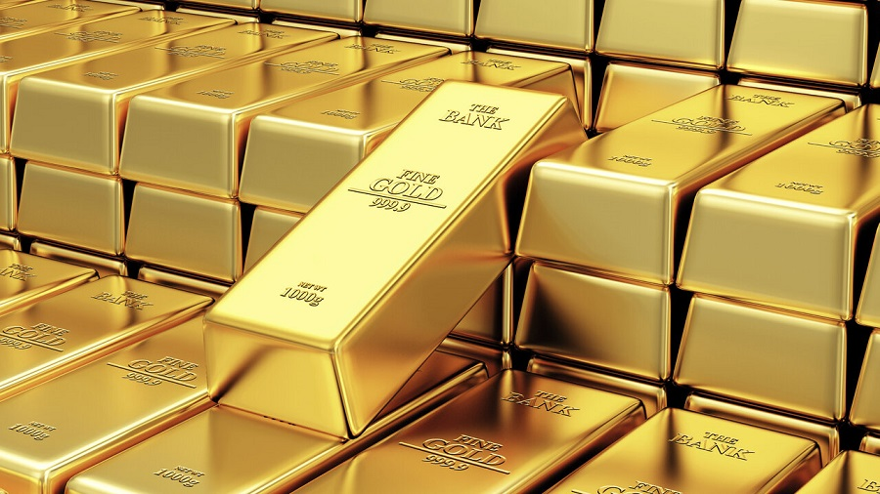
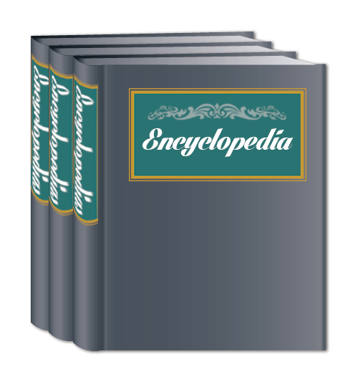
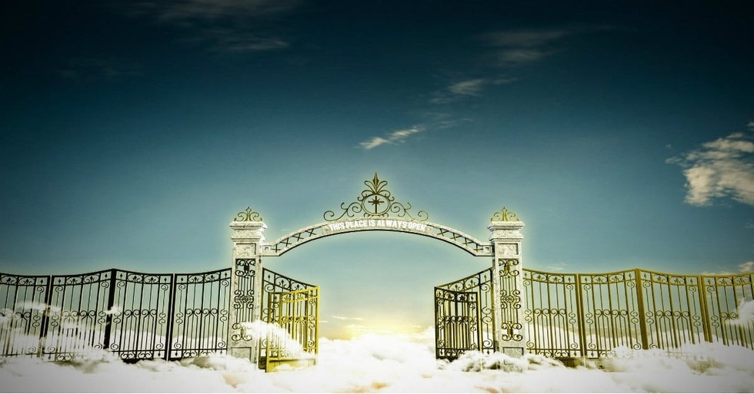
…
Simile
SIMILE is used to compare dissimilar things indirectly, by using ‘as’ or ‘like’:
Visiting that country once, I found out it’s like heaven.
Wow! That young lady is as vast as an encyclopaedia.
Like the gold that goes through roaring fire on its journey to refinement, Catherine experienced so much turbulence before becoming the famed tycoon she is today.

Slide 5
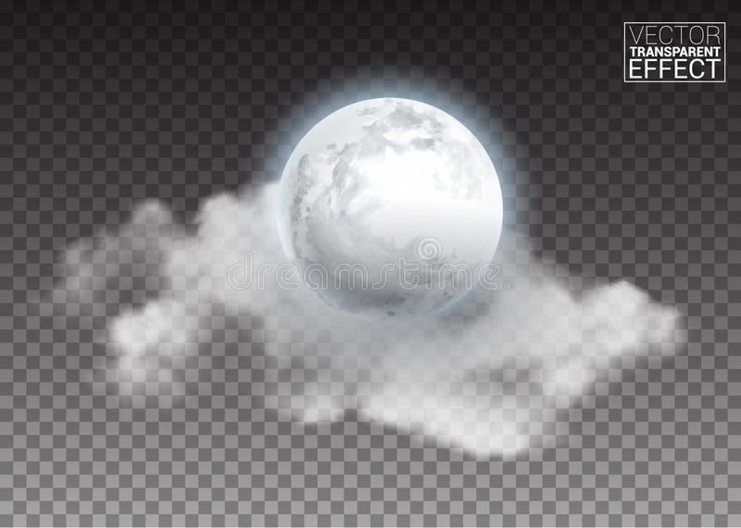
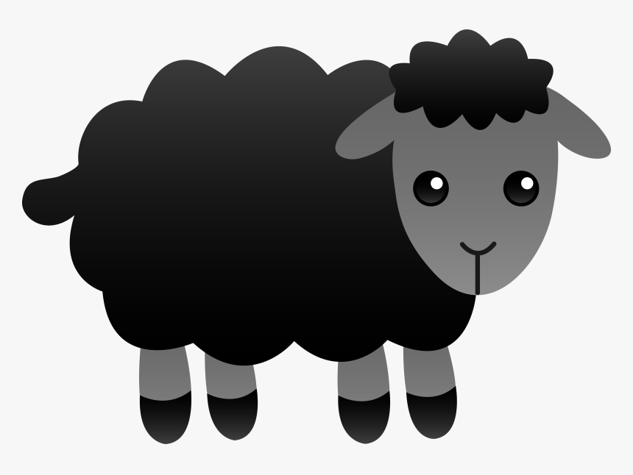
…
Metaphor
METAPHOR shows connections between unlike things or compares dissimilar things, without the use of ‘as or ‘like’:
She is a bloody black sheep in that family!
His heart of stone surprised me.
I have two very important friends in my life. One is a sunlight; the other is a moon.

Slide 6
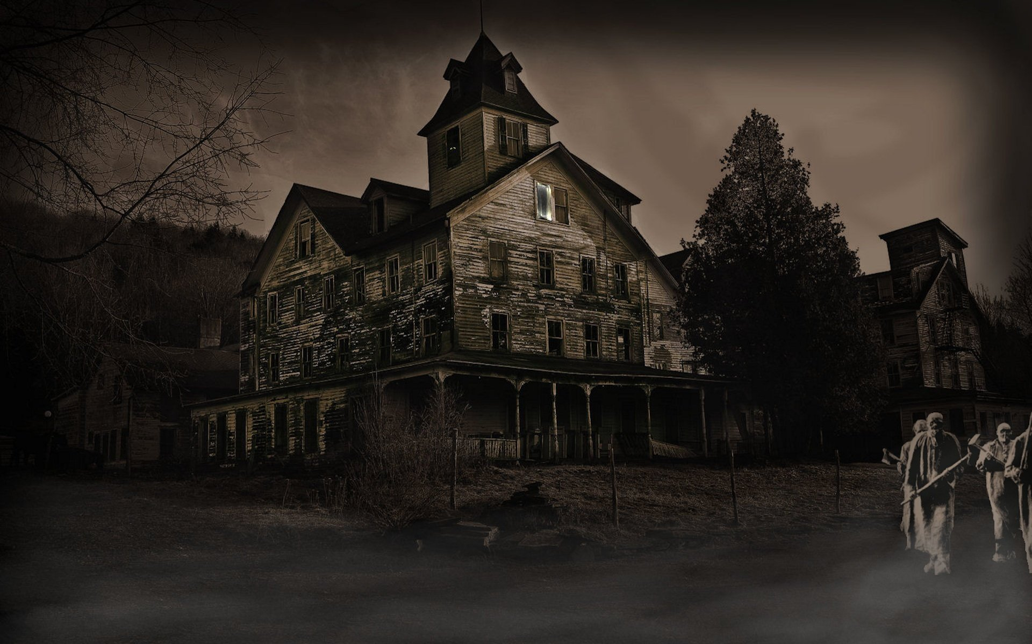
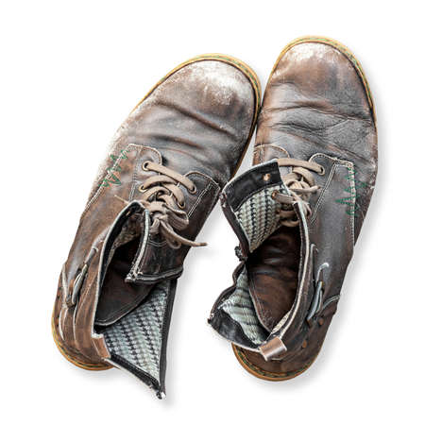
Personification
PERSONIFICATION is an expression that gives animate attributes to inanimate objects, making lifeless objects seem as though they had lives.
The blood of murdered protesters will haunt the brutal soldiers.
The tired shoes cry to be allowed to retire peacefully.
We could still hear the deserted building whispering some cryptic words.

Slide 7
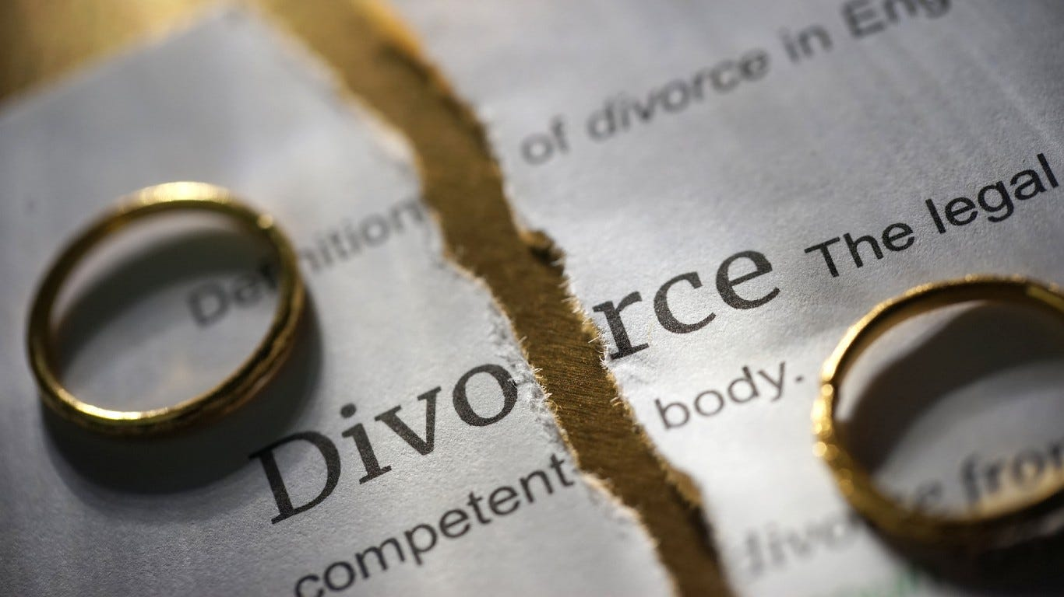
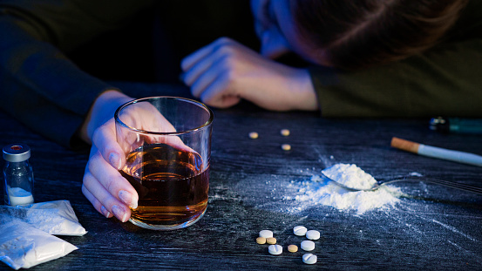
Irony
IRONY is a statement that means the opposite of the speaker’s intention and it’s commonly used for humour or ridicule:
Yes, he was such a big inspiration to the twins! The drugs he introduced them to caused their eventual destruction.
When I heard that my marriage counsellor friend wanted a divorce from her police officer husband, I rushed to the husband’s office to see what I could do to help save their marriage. There, I was told the police station just got robbed and the husband had been kidnapped.

Slide 8
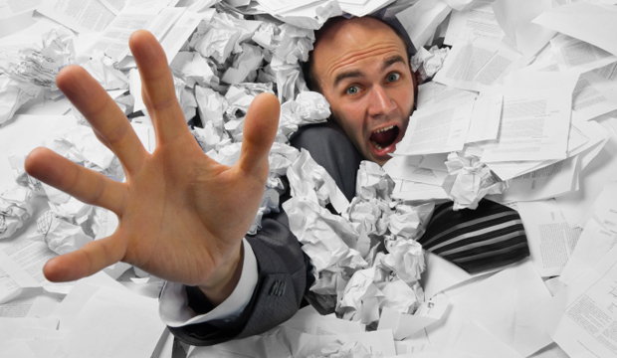
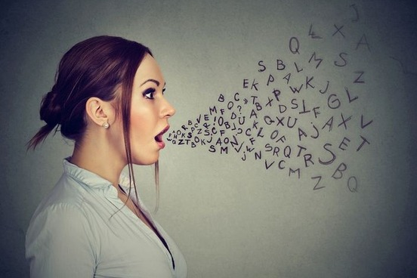
Hyperbole
HYPERBOLE is an overblown statement, intended to amaze and amuse people.
She is drowning in paperwork; I pray the job doesn’t kill her soon.
I have a million reasons why you should listen to your parents.
She is too loud when she talks. I can’t stand a woman who talks in Lagos and London residents hear the echo.

Slide 9
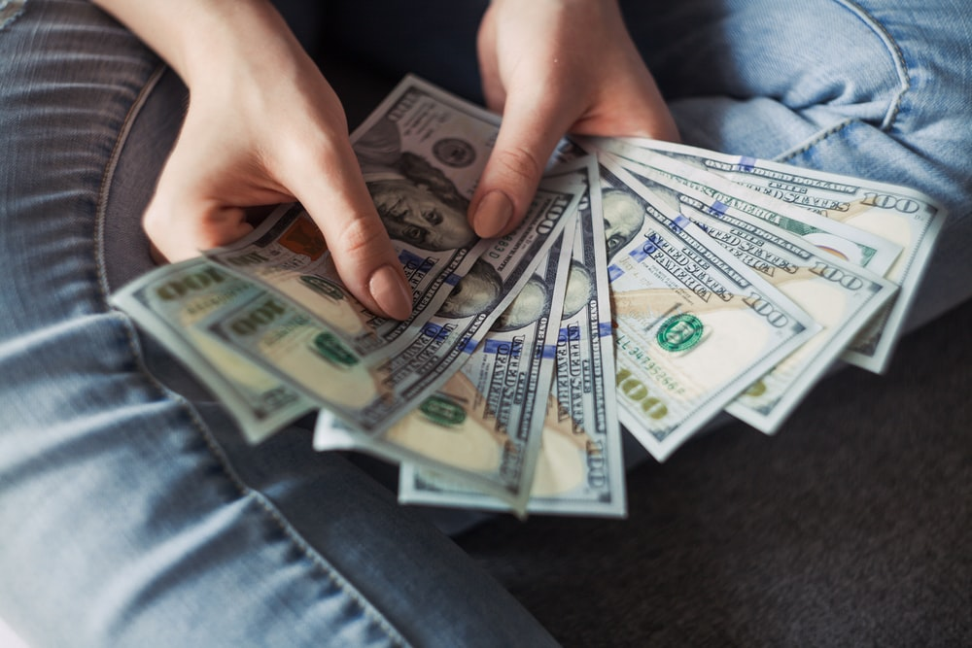
Paradox is a statement that, at first, appears or sounds self-contradictory or absurd but when deeply considered, is found to contain some element of truth.
The enemy of my enemy is my friend.
You earn money by spending it.
“If everyone is special, no one is special.” (Disney’s The Incredibles).
Paradox

Slide 10
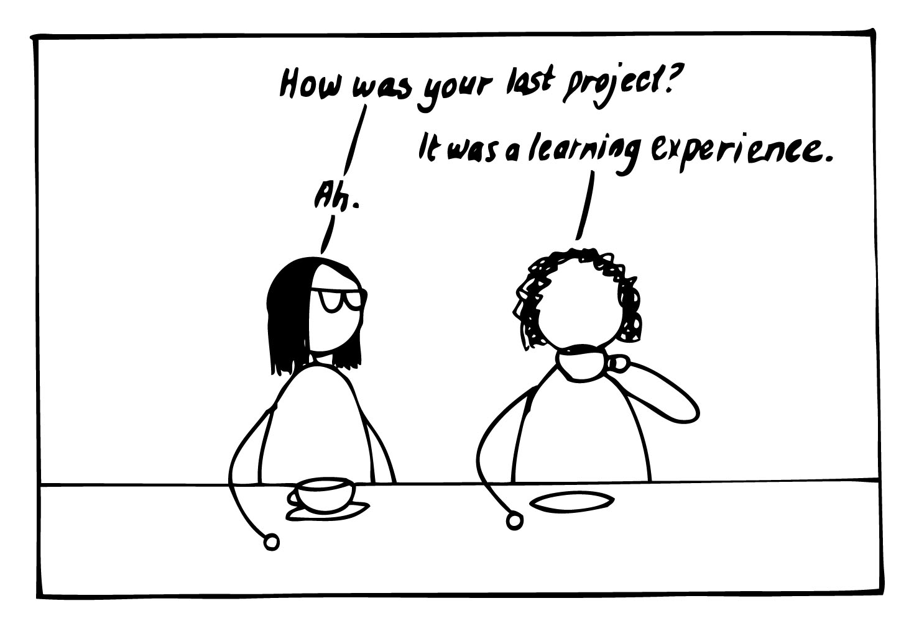
Euphemism
Euphemism is a statement expressing some harsh or ugly realities in a milder way such that the harshness or ugliness is not very noticeable.
Because we were trying to cut down on our expenses, we had to let some workers go (sack them / make them lose their jobs)
He kicked the bucket after just a simple illness.
The last time I ate this meal at work, I had to excuse myself a few times to break wind (to fart)
Excuse me; I’d like to powder my nose (use the toilet).

Slide 11
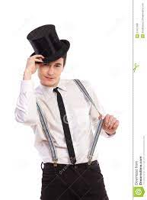
SYLLEPSIS is an expression, in which ONE word is used to express two different kinds of meaning, such that one meaning is literal (ordinary), while the other meaning is figurative (metaphoric).
He took his hat and his leave.
The girl stole my money and my heart.
The robbers killed her son and her future.
SYLLEPSIS

Slide 12
Synecdoche is a figure of speech in which a part of something or someone is used to represent the whole of that thing.
Dad always advises me to respect grey hair.
I just bought new wheels (new cars)
SYNECDOCHE

Slide 13
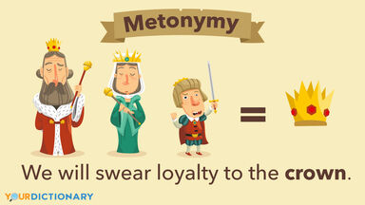
Metonymy is the use of something closely related to an object to refer to the object.

Slide 14
v

Slide 15
…
CLASS TASK
“Make Hay While the Sun Shines.”
“Birds of a feather flock together.”
“All that glitters is not gold.”
"An apple a day keeps the doctor away.“
Choose any one of the four idiomatic / metaphoric expressions here and create a captivating story based on the meaning of the expression.
Tell your story using any of these genres:
Poetry (poem)
Prose (short story)
Drama (playscript)

Slide 16
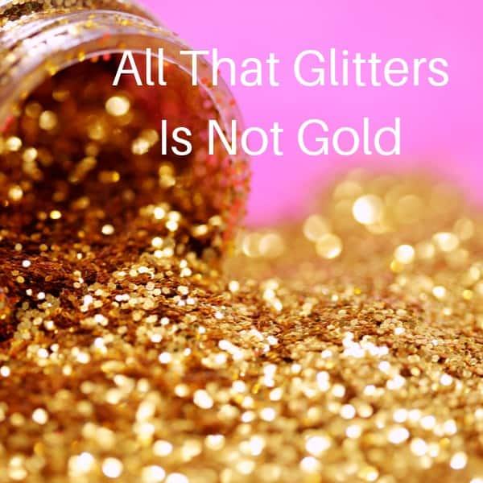
…
Physiognomy
There was a man I saw
I looked at him with awe
I thought he'd have the world
I can't describe with word
His looks that had no flaw
He had a rare nature
Gentle from sole to crown
He rarely wore a frown
His kind was rare in town
He’s a perfect creature!
I envied his nature
So schooled in every grace
His gestures and stature
Sure took years to nurture
I long to have his place
Was he from this culture?
So young in face and age
His words were few but sage
One ugly night in May
I heard he passed away
My heart got a puncture
I raged he died a youth
In death, he bared the truth
Many secrets he kept
Confessed in notes he left
The man we thought was couth
Traded his soul for wealth
He ached in hide till death
His heart was full of wounds
With none he shared the wounds

Slide 17
…
No wife nor kids nor kin
For none he left his things
From this tale I've just told
What glitters' not all gold.
© adebesin.Ibraheem (2011)

Slide 18
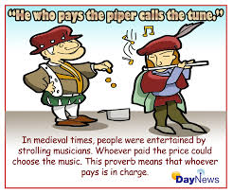
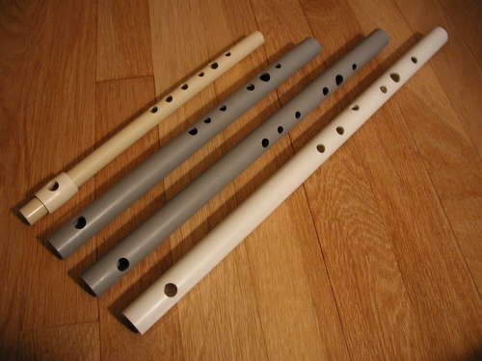
"He who pays the piper calls the tune.“
In medieval times, people were entertained by strolling musicians. Whoever paid the price could choose the music. This proverb means that whoever pays is in charge.

Slide 19
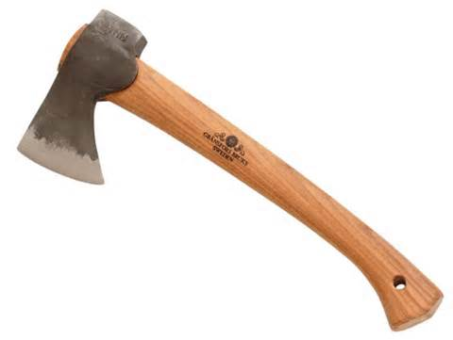
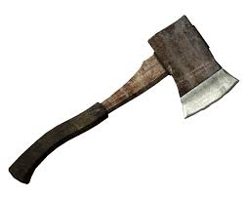
“Let’s bury the hatchet."
Native Americans used to bury weapons to show that fighting had ended and enemies were now at peace. Today, the idiom means to make up with a friend after an argument or fight.

Slide 20
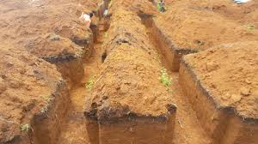
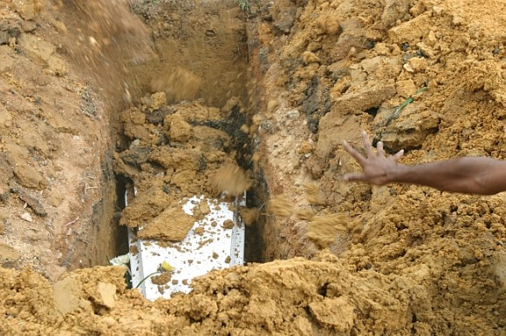
“Earth is the queen of beds.”

Slide 21
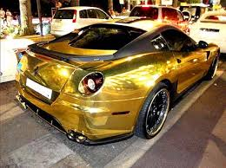
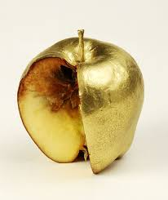
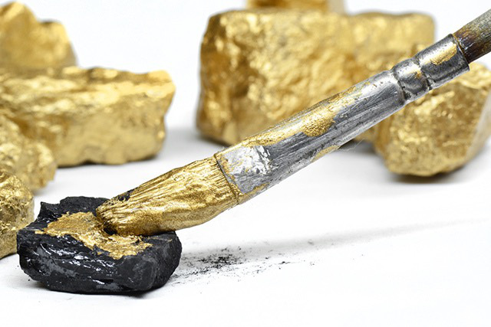
“All that glitters is not gold”

Slide 22
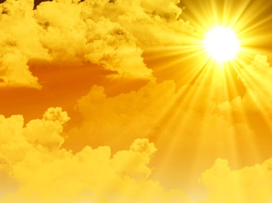
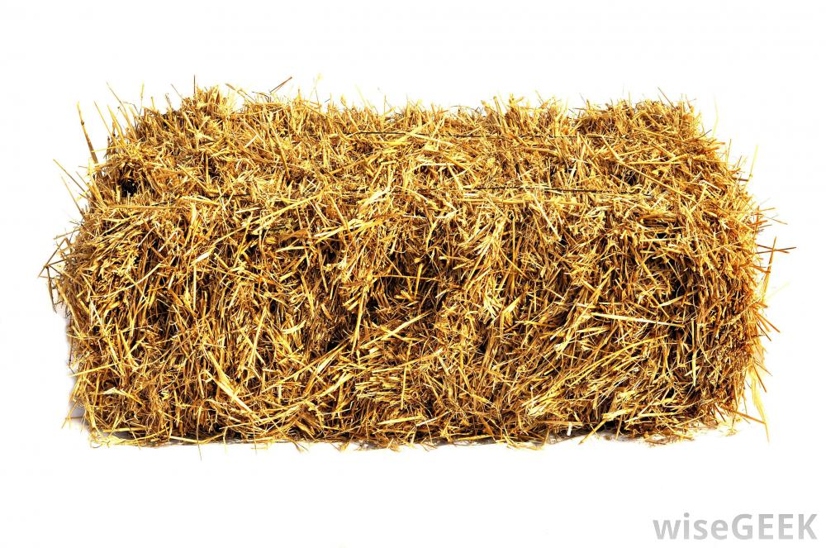
“Make Hay While the Sun Shines”

Slide 23
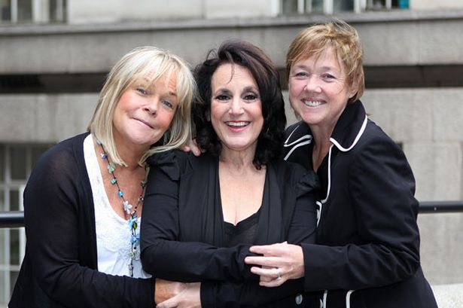
Proverbs
“Birds of a feather flock together”

